Slide 1


Template Tracking
Chi Liu
Carnegie Mellon University
chil1@andrew.cmu.edu
2016.1.11
Loading……
Notes:
chil1@andrew.cmu.edu

Slide 2
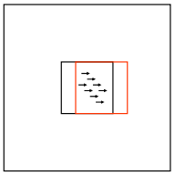
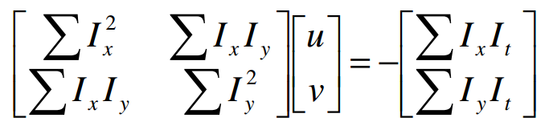
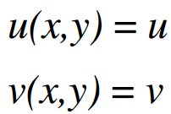
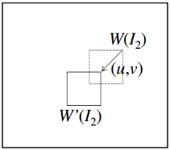
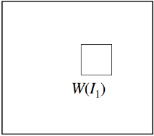
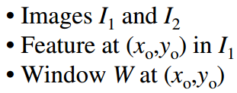
Lucas-Kanade Tracking
L-K Tracking
Testing car Sequence
Template Tracking
How to calculate [u;v]
Constant flow
Iterating [u;v]
*

Slide 3
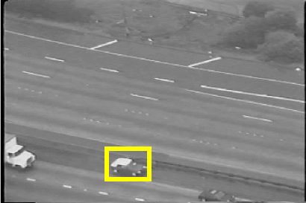
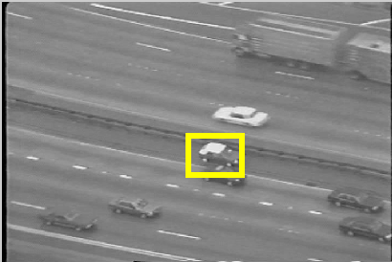
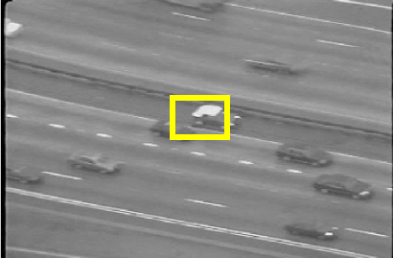
Testing car sequence
L-K Tracking
Testing car sequence
Template Tracking
Frame 20
Frame 60
Frame 80
Frame 1-40
*

Slide 4
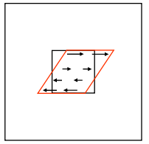
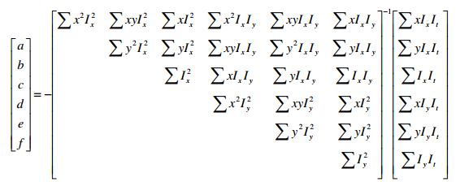
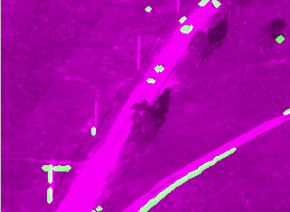
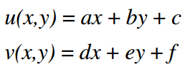
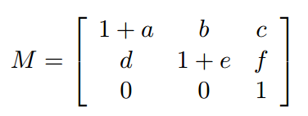
Template Tracking
L-K Tracking
Testing car Sequence
Template Tracking
How to calculate M
Affine flow
X_{t+1}=M X_{t}
Result: white is moving things
*

Slide 5
THANKS
Chi Liu
Carnegie Mellon University
2016.1.11

